Slide 1
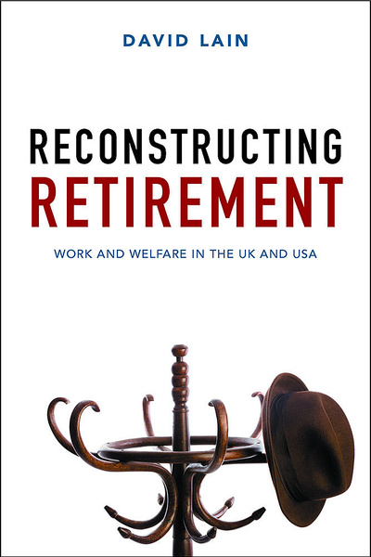
Bridges to working late? Un-retirement, Part-time work, and Self-employment in the United States and England
David Lain Mariska van der Horst Ignacio Madero-Cabin Estaban Calvo Sarah Vickerstaff

Slide 2
Assumption of ‘gradual’ ‘bridge employment’ pathways to retirement emerging
John Cridland’s interim review of UK state pension ages:
‘The nature of work and retirement is changing, as people move from the old model of a fixed retirement age leading to a defined period of retirement to a more flexible approach where people may wish to work part-time or change career in later life’.
Is this simply ‘bridge employment’, identified in the US in 1990s?:
“today, for many people retirement also can mean a transition into some type of "bridge employment," that is, a part-time job, self-employment, or temporary employment after full-time employment ends and permanent retirement begins” (Feldman, 1994: 284).
Does ‘bridge employment’ commonly lead people to work late?

Slide 3
‘Deconstrucing’ the logic of bridge employment
Implies downsizing or status-change following ‘career job’, including move into part-time work, self-employment ‘un-retirement’ (return to work following retirement).
Implies a structured pathway moving from ‘career employment’, to bridge employment, to ‘full’ retirement.
Implies working ‘late’, given focus on working ‘in retirement’ and the reasons for the growth of bridge employment.
Research does not show that US bridge employment is common, in the sense of involving (1) changes in status, (2) structured pathways, and (3) late employment.
Also, (4) bridge employment may not be relevant for women.

Slide 4
Questions
In USA and England:
To what extent do late careers involve un-retirement and movements into part-time work and self-employment?
To what extent do pathways involving un-retirement and/or movements into part-time work and self-employment result in employment up to, and beyond, state pension age?
To what extent are ‘bridge pathways’ to late retirement a disproportionately male phenomenon?

Slide 5
Methods
US Health & Retirement Study / English Longitudinal Study of Ageing.
Follow people from approx age 60 to 70 (except English women – 55-65)
Labour force statuses: (1) full-time employee, (2) part-time employee, (3) self-employed, (4) retired (inactive), (5) disabled (inactive), (6) not in labour force (other reason), and (7) deceased.
Analysis:
Percentages of people ‘un-retiring’ or moving into part-time / self employment at least once.
Sequence analysis followed by cluster analysis to identify pathway types. (SA based on optimal matching; Ward Clustering).
Multi-nomial logistic regression to examine gender differences in being in different ‘bridge employment’ pathway clusters.

Slide 6
1: Percentage of un-retirement, self-employment, and part-time job transitions in the United States and England

Slide 7
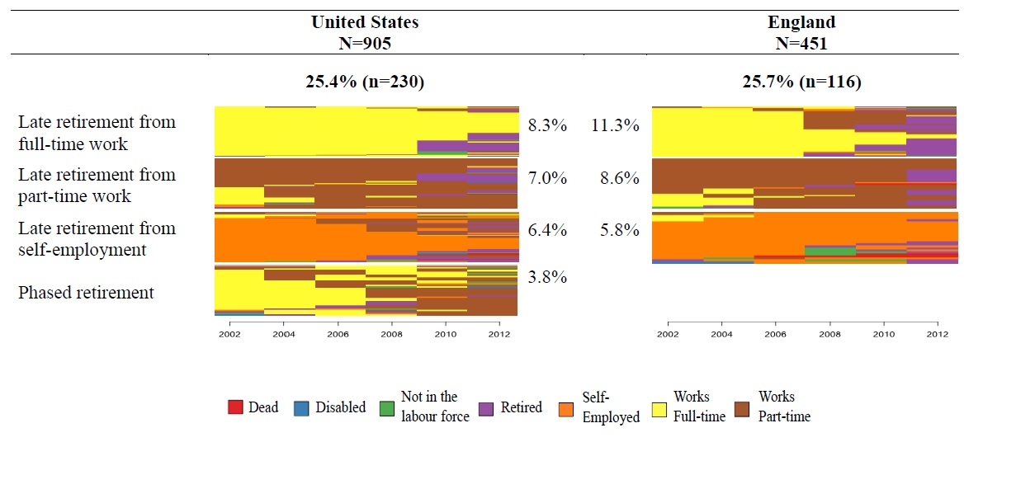
2: Late employment clusters

Slide 8
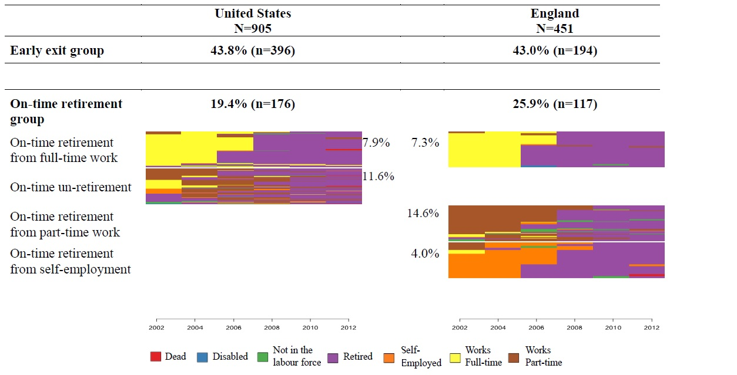
2: ‘On-time’ employment clusters

Slide 9
3: Bridge employment a male phenomenon? Results of multinomial logistic regression
Little bridge employment discovered: ‘phased retirement’ in the USA (3.8%) – multi-nomial logistic regression showed no significant difference between men & women in this cluster.
Men significantly more likely to be in one of the ‘late employment’ clusters in US.
Women significantly more likely to be in one of the ‘late employment’ clusters in US (younger group).

Slide 10
Conclusions
Near-consensus in the US that moves into bridge employment in older age are the norm.
Concept of bridge employment helpful for academics (gives older workers agency) and policy makers (humane extended working lives).
But for bridge employment to be meaningful needs to be structured pathways to working late (un-retirement, part-time, self-employment).
Examined using sequence / cluster analysis.
Few people in bridge employment ‘pathway clusters’ – 3.8% in phased retirement pathway in USA. None in England.
Overemphasizing bridge employment enables policymakers to present an overly-optimistic picture of older worker prospects.

